Slide 1
Fundamentals of Computer Networking
11 SEPT 2020
Session-1

Slide 2
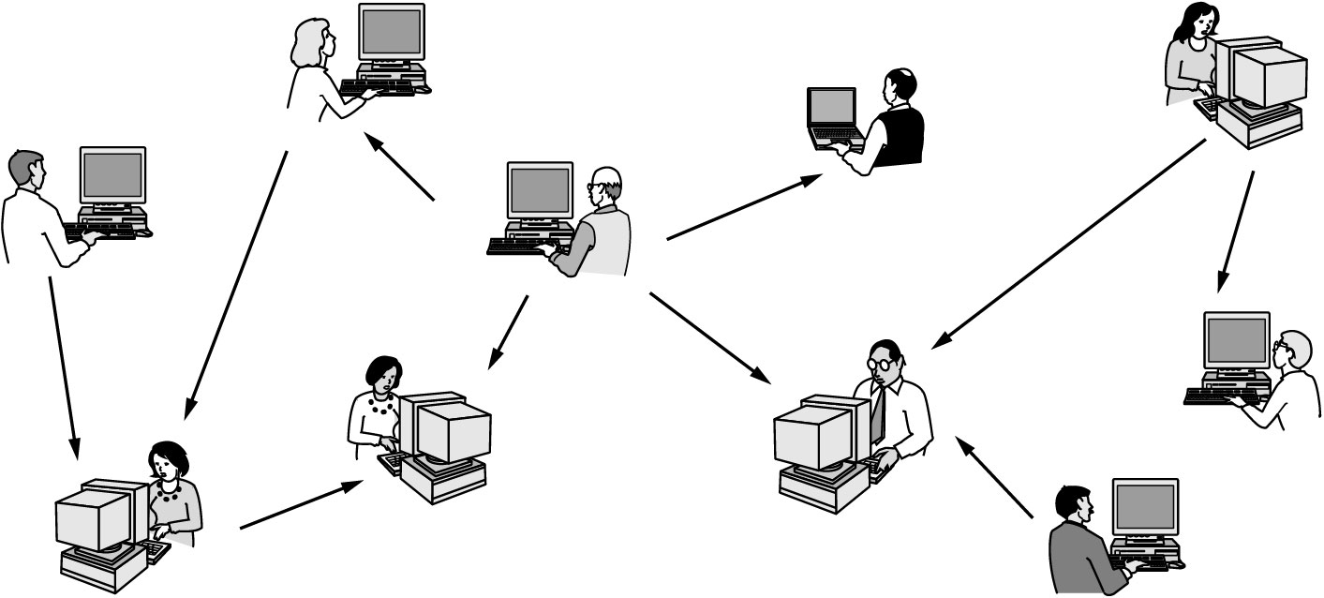
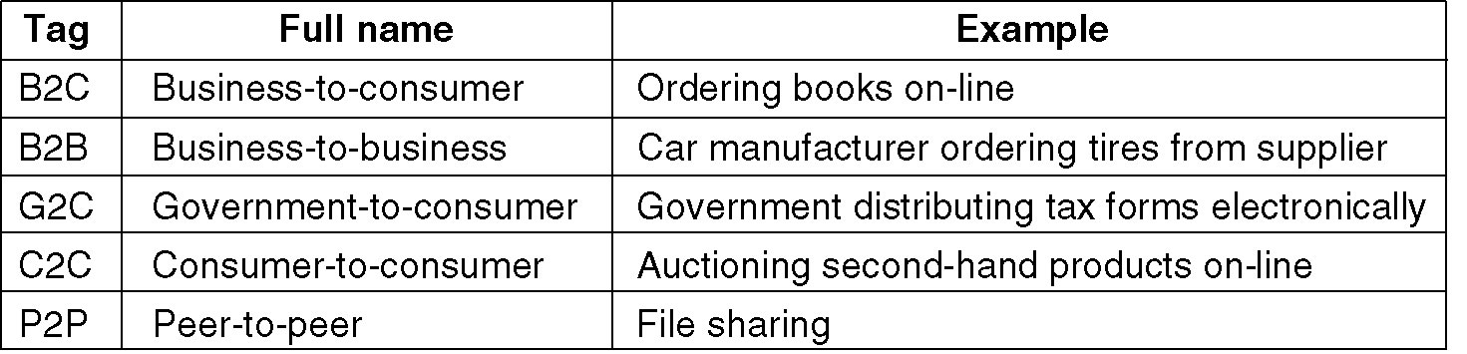
Why we need Computer Networks
Application Type

Slide 3
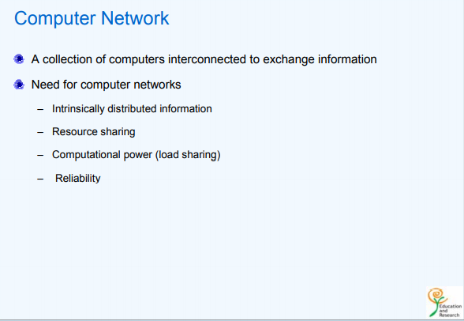

Slide 4
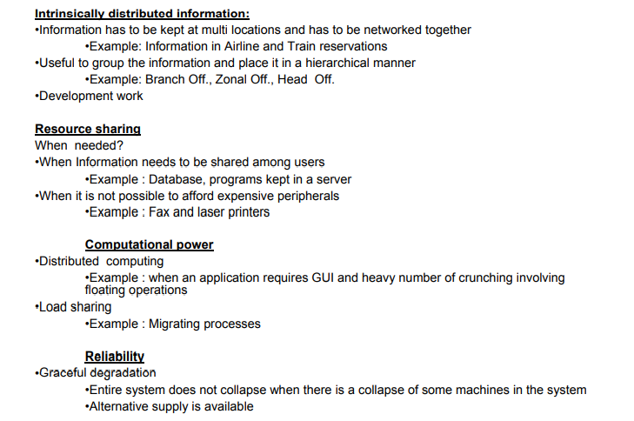

Slide 5
Client-Server Concepts

Slide 6
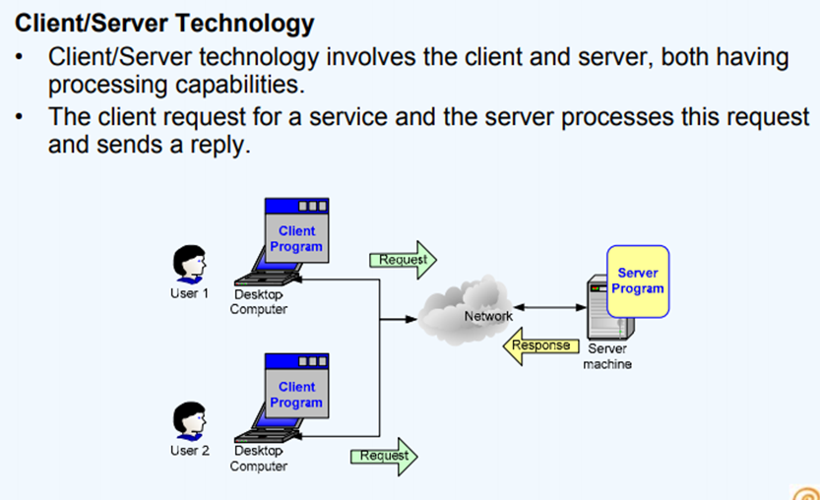

Slide 7
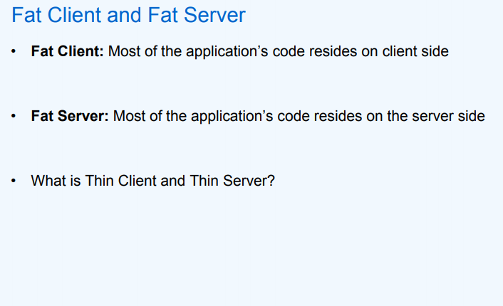

Slide 8
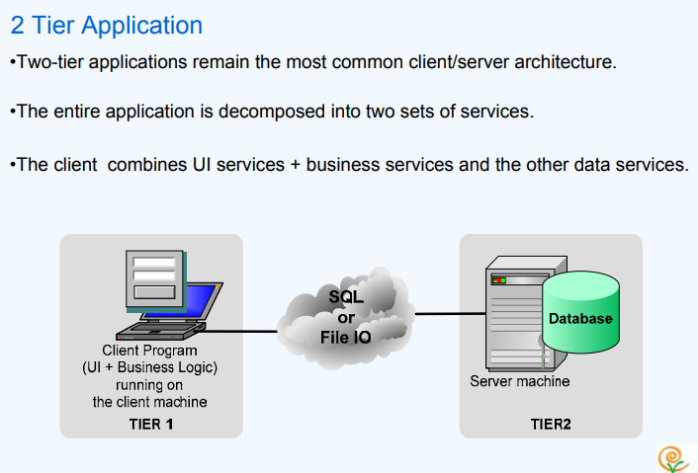

Slide 9
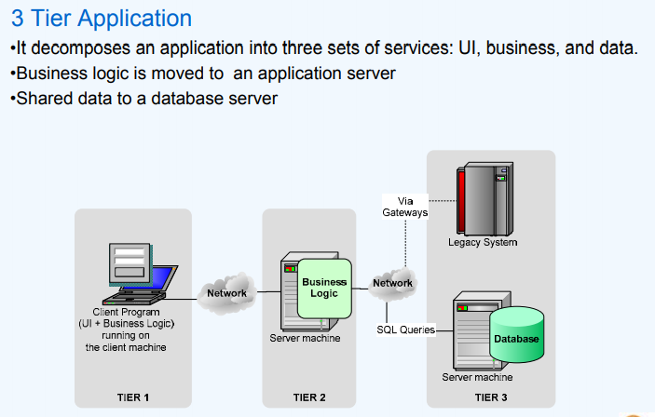

Slide 10
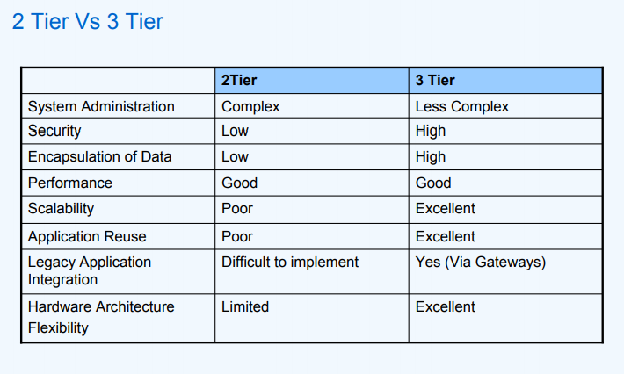

Slide 11
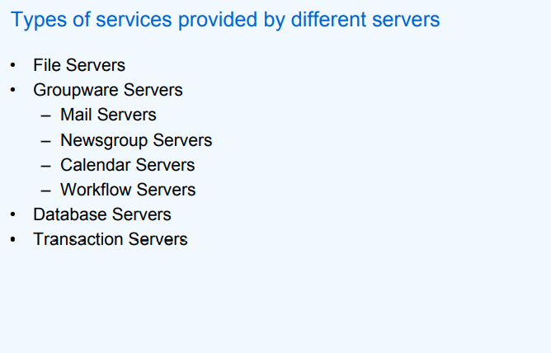

Slide 12
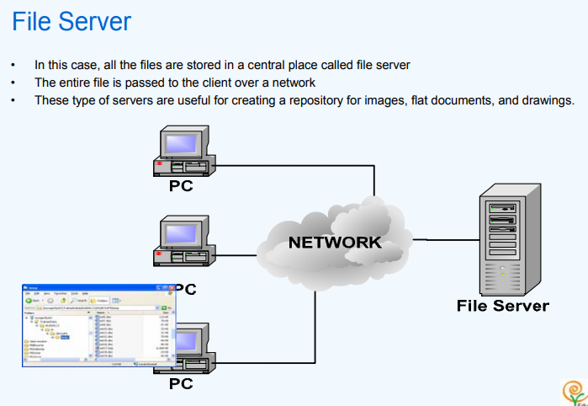

Slide 13
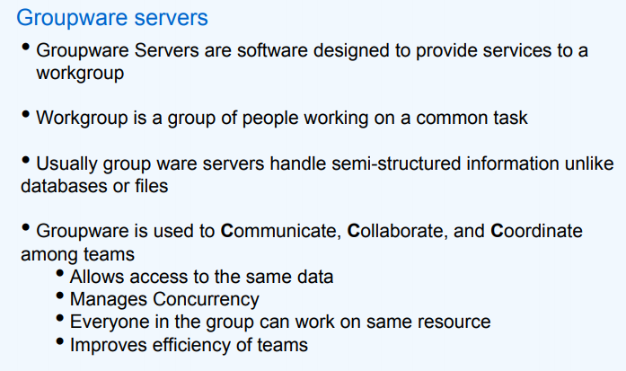

Slide 14
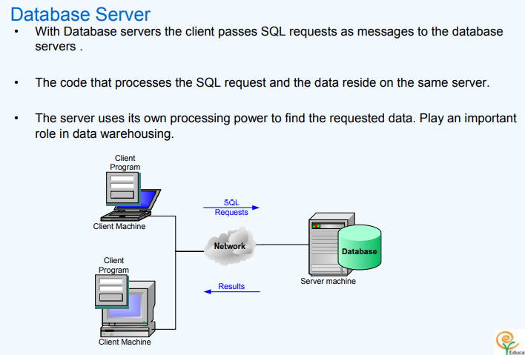

Slide 15
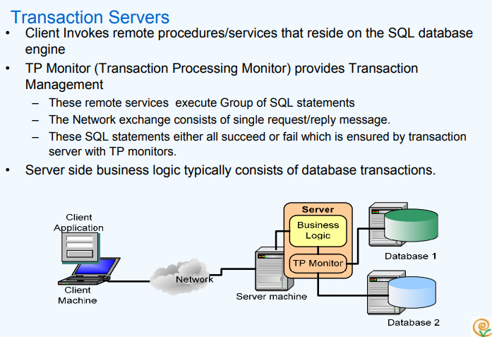

Slide 16
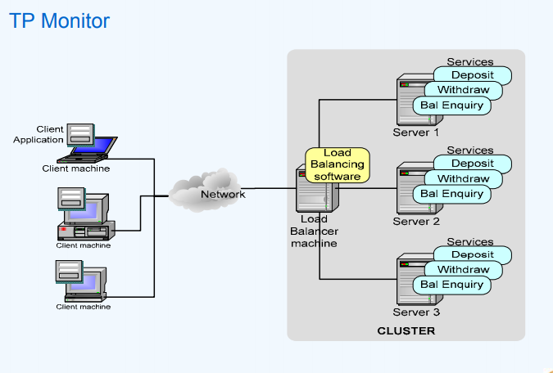

Slide 17
Types of Communication Networks
Classification according to the way the “information flows” are transported to the users
Switching Networks
Broadcast Networks
Notes:
17
DIMITRIOS MAKRAKIS, SITE, U OF O

Slide 18
Switching Networks
Data are transferred from source to destination through a series of intermediate nodes
Notes:
18
DIMITRIOS MAKRAKIS, SITE, U OF O

Slide 19


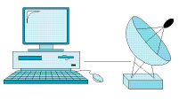

Broadcast Networks
--There are no intermediate switching nodes
--All users are connected on the same medium
Satellite
Notes:
19
DIMITRIOS MAKRAKIS, SITE, U OF O

Slide 20
Two ways to share
Circuit switching (isochronous)
Packet switching (asynchronous)

Slide 21
Circuit Switching
It’s the method used by the telephone network
A call has three phases:
Establish circuit from end-to-end (“dialing”),
Communicate,
Close circuit (“tear down”).
If circuit not available: “busy signal”
Boston Switch
LA Switch
Caller
Callee
processing delay at switch
propagation delay
between caller and
and Boston switch
(1)
DATA
(2)
(3)

Slide 22
Circuit Switching
Uses a dedicated path between two stations
Process consists of three phases
establish
transfer
disconnect
Bandwidth inefficient
channel capacity dedicated for duration of connection
if no data, capacity wasted
Set up (connection) takes time
Once connected, transfer is transparent
Can provide deterministic performance guarantees
Notes:
22
DIMITRIOS MAKRAKIS, SITE, U OF O

Slide 23
Packet Switching
Used in the Internet
Data is sent in Packets (header contains control info, e.g., source and destination addresses)
Per-packet routing
At each node the entire packet is received, stored, and then forwarded (store-and-forward networks)
No capacity is allocated
Host 1
Host 2
Node 1
Node 2
Header
Data
propagation
delay between
Host 1 &
Node 2
Packet 1
transmission
time of Packet 1
at Host 1
Packet 2
processing delay of Packet 1 at Node 2
Packet 1
Packet 3
Packet 2
Packet 3
Packet 1
Packet 2
Packet 3

Slide 24
Packet Switching
circuit switching was designed for voice
packet switching was designed for data
transmitted in “small” packets
packet contains user data and control info
user data may be part of a larger message
control info includes routing (addressing) info
packets are received, stored briefly (buffered) and passed on to the next node
Notes:
24
DIMITRIOS MAKRAKIS, SITE, U OF O

Slide 25
Transmission Mode
Simplex
Half-duplex
Full-duplex

Slide 26
Line Discipline
ENQ/ACK
Point-to-point

Slide 27
Line Discipline (…)
Multi-point

Slide 28
Select Line Discipline

Slide 29
Poll Line Discipline

Slide 30
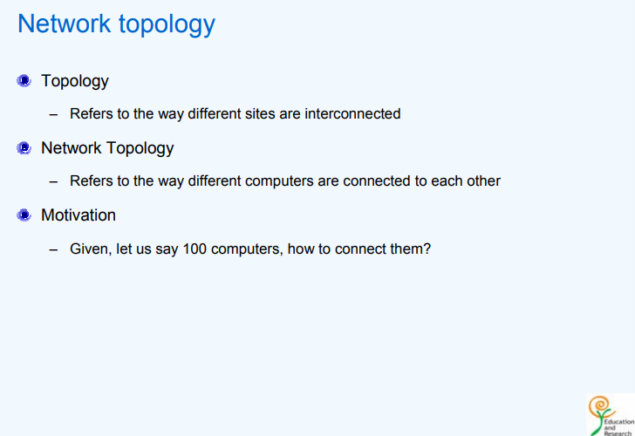

Slide 31
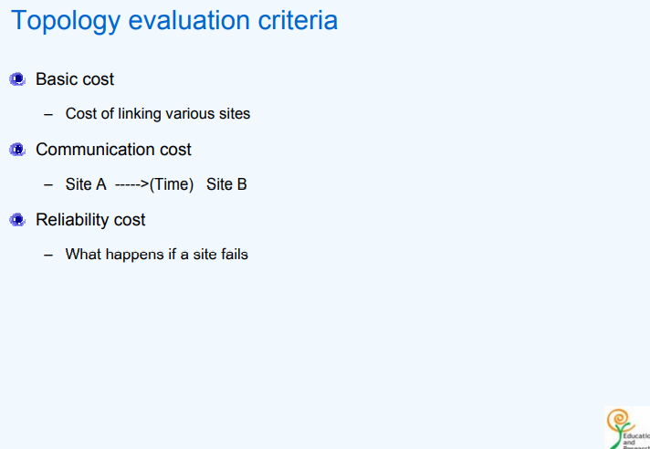

Slide 32
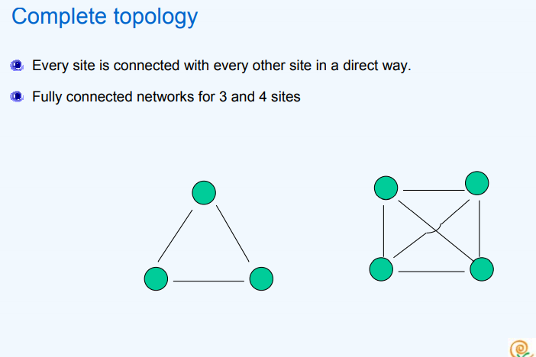

Slide 33
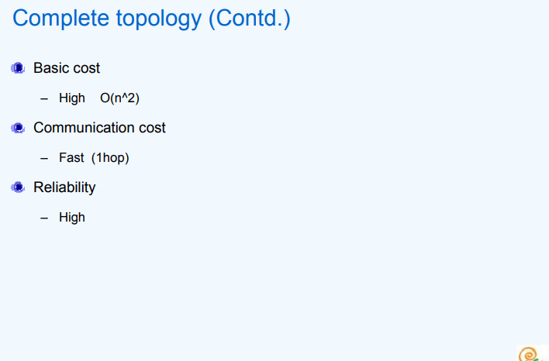

Slide 34
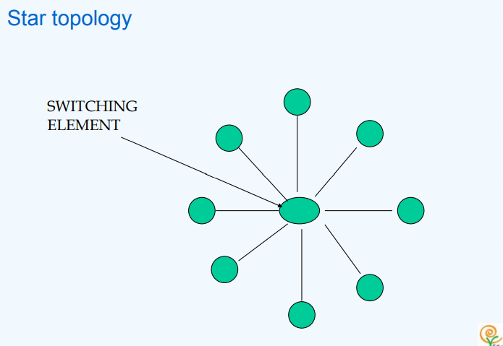

Slide 35
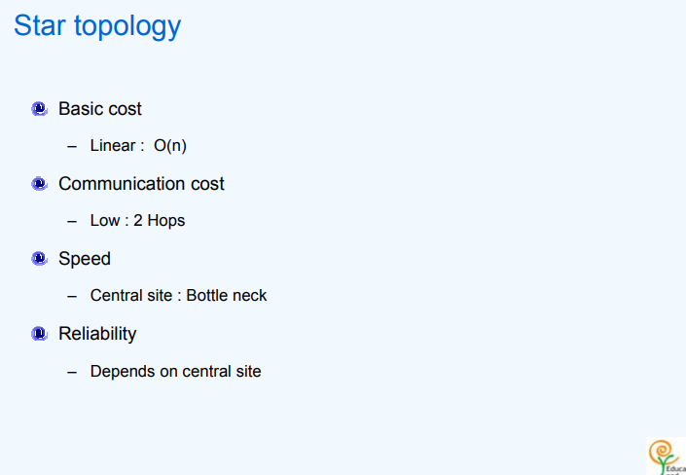

Slide 36
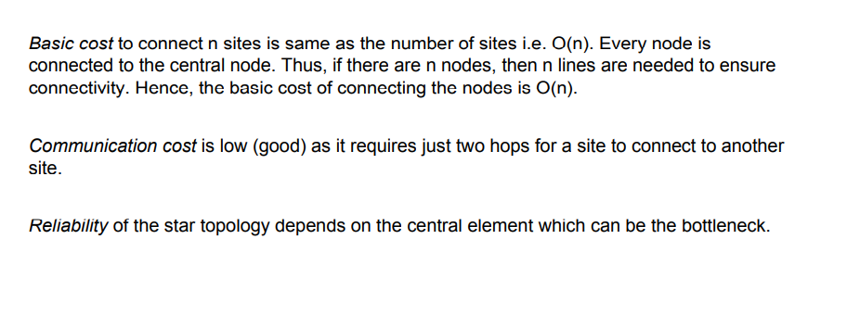

Slide 37
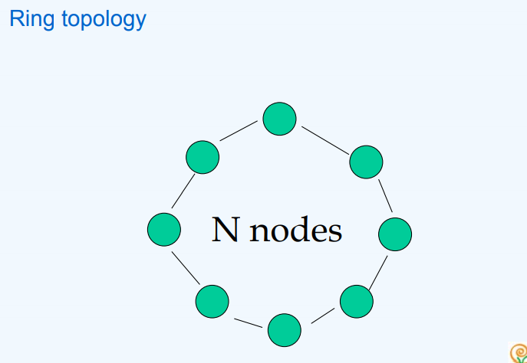

Slide 38
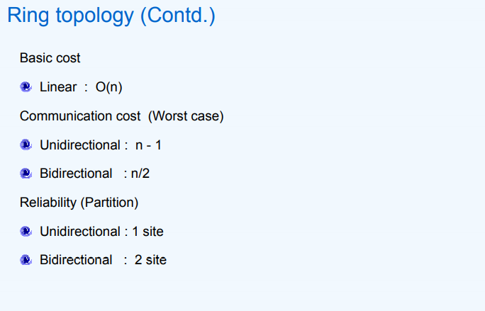

Slide 39
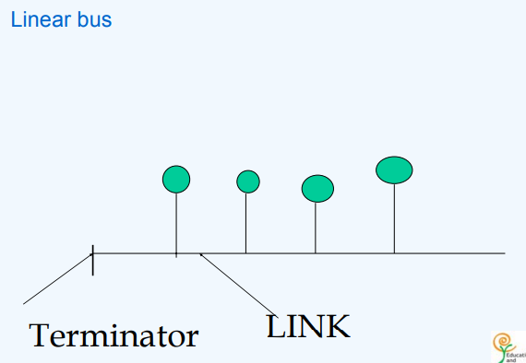

Slide 40
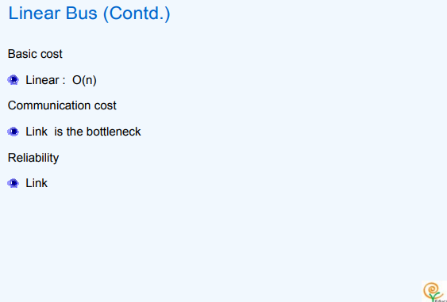

Slide 41
Classification According to Coverage Area
Local Area Networks (0-2 Km; campus)
Ethernet (10/100/1000 Mbps), Token ring (4, 16 Mbps),
Metropolitan Area Networks (2-50 km; corporate offices, city)
DQDB (Distributed Queue Dual Bus), WiMAX
Wide Area Networks (country, continent)
transmission lines, switching elements
Personal Access Networks (PANs)
Bluetooth
Notes:
41
DIMITRIOS MAKRAKIS, SITE, U OF O

Slide 42
Local Area Networks (LANs)
It expands over small geographic areas (within a building or close-by buildings)
It is usually owned by the same organization
The internal data rates are typically much greater than those of WANs
Typically, they make use of broadcast rather than switching
Notes:
42
DIMITRIOS MAKRAKIS, SITE, U OF O

Slide 43
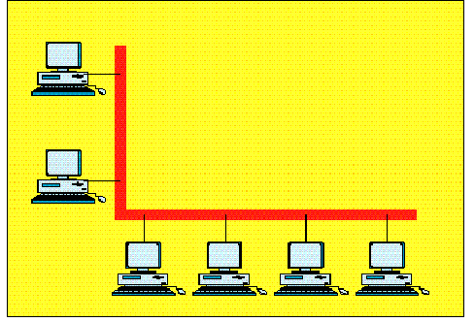
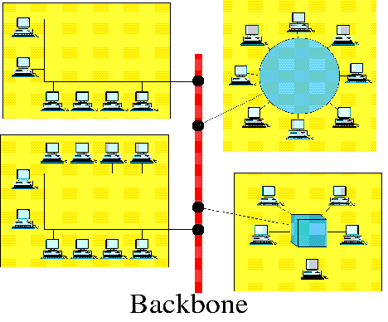
Local Area Networks (LANs)
Backbone
Single-building LAN
Multi-building LAN
Examples: home network, wireless-wired campus network
Notes:
43
DIMITRIOS MAKRAKIS, SITE, U OF O

Slide 44
Metropolitan Area Networks (MAN)
Notes:
44
DIMITRIOS MAKRAKIS, SITE, U OF O

Slide 45
Wide Area Networks (WAN)
Traditionally, WANs have been implemented using one of two technologies
Circuit Switching
Packet Switching
Datagram
Virtual Circuit
Notes:
45
DIMITRIOS MAKRAKIS, SITE, U OF O

Slide 46
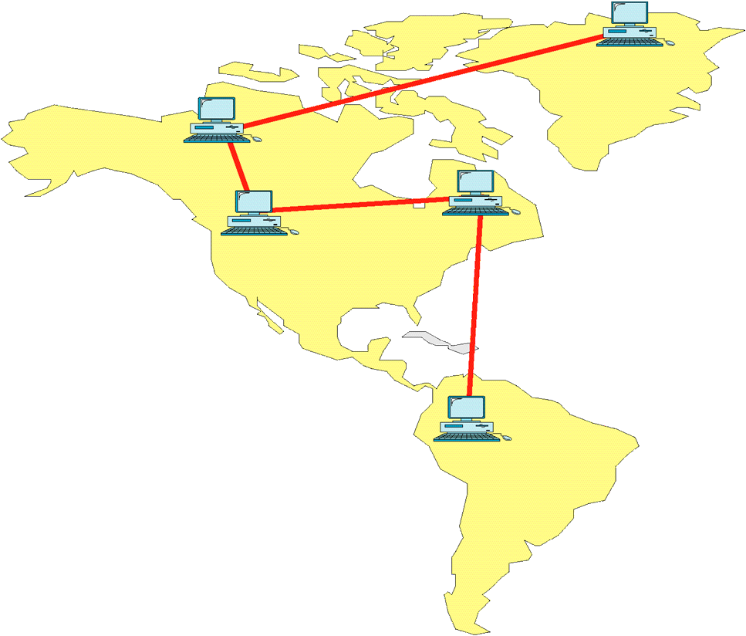
Wide Area Networks (WAN)
Example: Canadian Network for the Advancement of Research, Industry and Education (CANARIE).
Notes:
46
DIMITRIOS MAKRAKIS, SITE, U OF O

Slide 47
OSI Model
Open System Interconnection.
An ISO standard

Slide 48
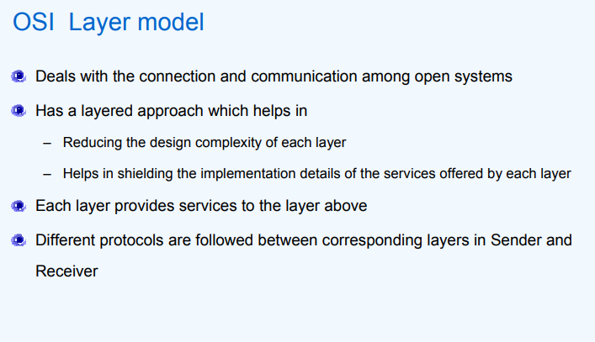

Slide 49
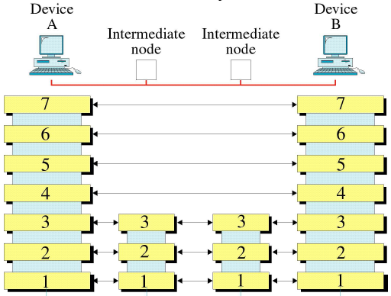
OSI Reference Model
Application
Presentation
Session
Transport
Network
Link
Physical
Notes:
49
DIMITRIOS MAKRAKIS, SITE, U OF O

Slide 50
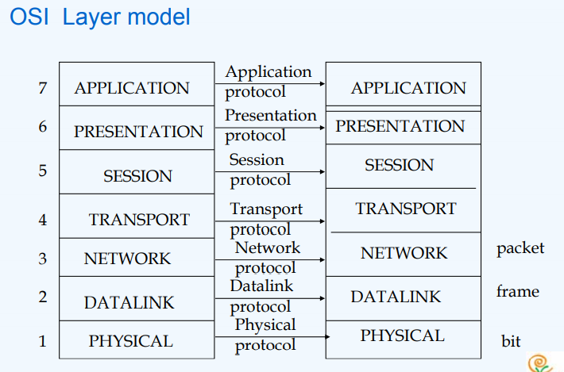

Slide 51
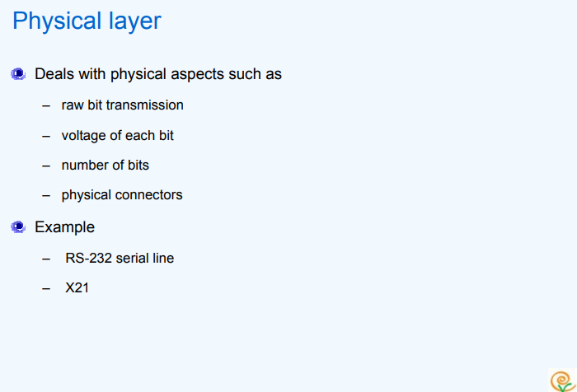
Deals with network hardware, bit encoding.
Examples: copper, fiber, radio, satellite.

Slide 52
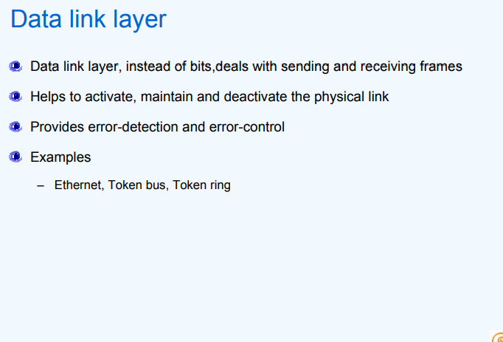
Deals with framing, windowing, flow control, error detection and recovery.

Slide 53
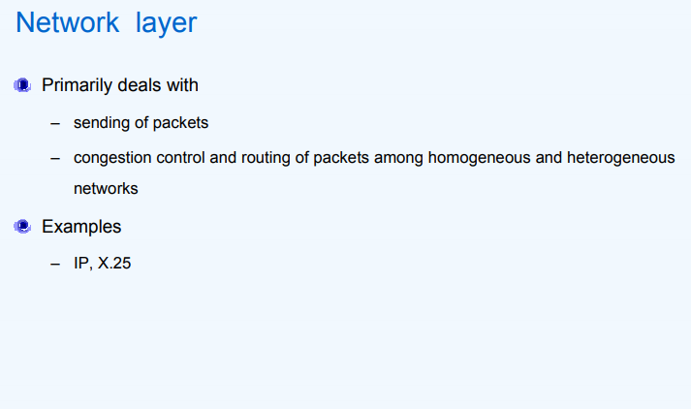
Determines how best to route packets of data from source to destination via intermediate network nodes.
Deals with addressing, routing, fragmentation, and congestion.

Slide 54
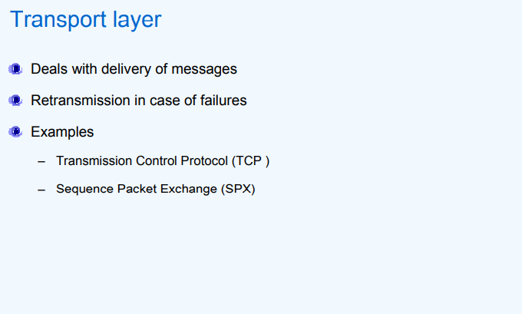
Provides end-to-end message delivery and error recovery.
Deals with end to end integrity and quality of service.

Slide 55
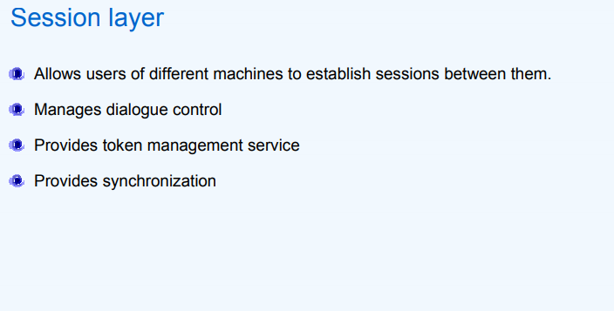
To establish, manage, and terminate sessions.
Controls the dialogue between two host applications.
Reports exceptions to upper layers.

Slide 56
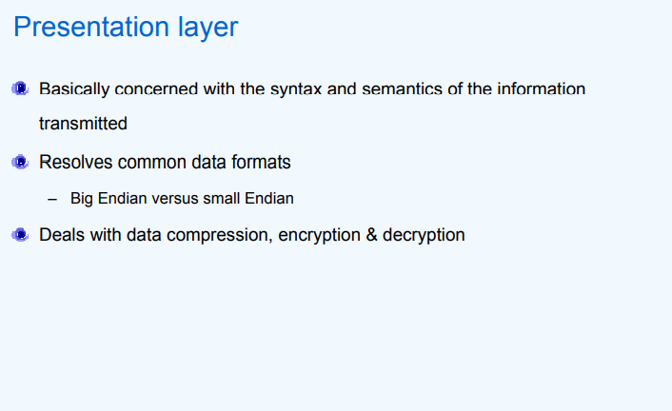
Resolves data representation differences.
To translate, encrypt, and compress data.

Slide 57
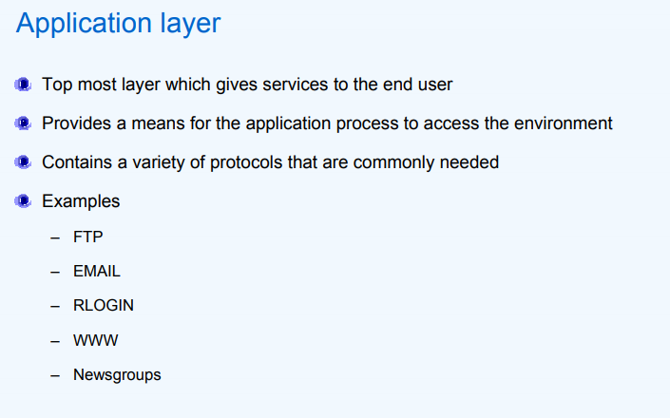
Perform functions to implement network applications.
E.g.; e-mail, teleconferencing.

